Slide 1



AI For Leaders
Dr. Basma M. Hassan
Faculty of Artificial Intelligence
Kafrelsheikh University
2025/2026

Slide 2
AI For Leaders
Lecture)5)
Power BI Essentials
Prepared by: Mahmoud Abo El-Naga,
AI Student KFS | Robotics

Slide 3


Data Analysis and Power BI
What is Data Analysis?
Data Analysis is the process of examining, cleaning, transforming, and modeling data to discover useful information, draw conclusions, and support decision-making.
Why do companies need Data Analysis?
To understand customer behavior.
To improve products and services.
To make smarter, data-driven decisions.
To increase sales and reduce costs.

Slide 4
Data Analysis and Power BI
Why Power BI?
Power BI helps turn raw data into clear and interactive reports and dashboards, making it easy for anyone to understand the story behind the numbers.
What is Power BI ?
Power BI is a business analytics tool by Microsoft that helps you turn data into interactive insights. It allows users to create reports and dashboards from a variety of data sources, such as Excel files, databases, or even cloud services.

Slide 5




Components of Power BI
Power BI Desktop
1
Create reports and dashboards on your computer.
Power BI Service
2
Publish and share reports online.
Power BI Mobile
3
View reports on your phone or tablet.
Power BI Gateway
4
Sync on-premises data with the cloud.

Slide 6

Basic Steps of Working with Power BI
Get Data Import data from various sources.
Transform Data Clean and shape the data using Power Query.
Create Reports Build visualizations and reports.
Publish Reports Share and publish reports to the Power BI Service.
Analyze and Share Insights Analyze data and share insights with others.

Slide 7

Basic Steps of Working with Power BI
How to Install Power BI Desktop
Download and install Power BI Desktop from the Microsoft Store or the official website.
How to Open a Data File (Excel, CSV, etc.)
Use "Get Data" to import files like Excel, CSV, or other data sources.
How to Create Visualizations
Create various charts like bar, line, pie, and map visualizations by dragging and dropping fields from your dataset into the report canvas.

Slide 8




Adidas Sales Analysis Using Power BI: Project Context
This project leverages Power BI, a leading business intelligence tool, to analyze and visualize sales performance data for Adidas across various U.S. states, product categories, and retail partners.
The goal is to assist decision-makers in understanding business dynamics and optimizing strategies based on data.

Slide 9

The dataset, titled "Adidas US Sales Datasets", is provided in Excel (.xlsx) format and contains detailed sales records for Adidas products across multiple dimensions.
Time Period: Spanning from May 2020 to December 2021
Sales Metrics: Includes total sales, units sold, price per unit, operating profit, and operating margin
Dimensions:
Dataset Description
State
Region
Retailer
Product Category Monthly Data

Slide 10
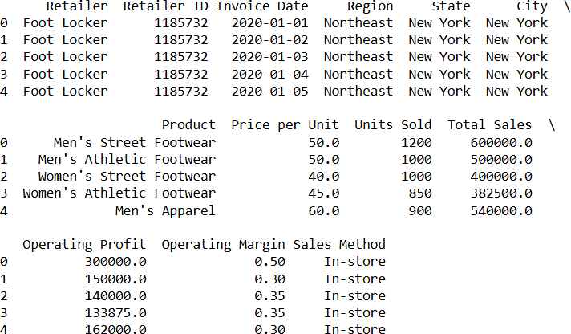
Dataset Description
[9648 rows x 13 columns]

Slide 11


Dashboard Overview
A dashboard is a dynamic visual tool that consolidates and presents data through charts, graphs, and KPIs to monitor performance and uncover insights at a glance.
Top Summary KPIs (Top Panel):
A KPI (Key Performance Indicator) is a measurable value that indicates how effectively a business is achieving its key objectives.
Total Sales: $816M – Shows the complete revenue generated during the period.
Operating Profit: $302M – Highlights the earnings after operational costs.
Units Sold: 2 million – Reflects total product volume sold.
Price per Unit: $45 – Average selling price.
Operating Margin: 42.4% – Indicates profitability efficiency.

Slide 12
Dashboard Overview
Visual Components:
Aear Chart – Total Sales by Month
Peaks observed in June and July suggest higher summer performance, possibly due to
seasonal promotions or product launches.
Pie Chart – Total Sales by State
Top-performing states like California and Texas are easily identifiable, helping in regional targeting and supply chain planning.
Donut Chart – Total Sales by Region
Groups states into five major regions. The Southeast is the largest contributor at 28.29%, offering insights into regional preferences and demand.
Bar Chart – Total Sales by Product
Men’s footwear and apparel dominate the sales, useful for guiding marketing and inventory decisions.
Bar Chart – Total Sales by Retailer
West Gear and Foot Locker are the top two, suggesting potential for strategic partnerships or exclusive launches.

Slide 13
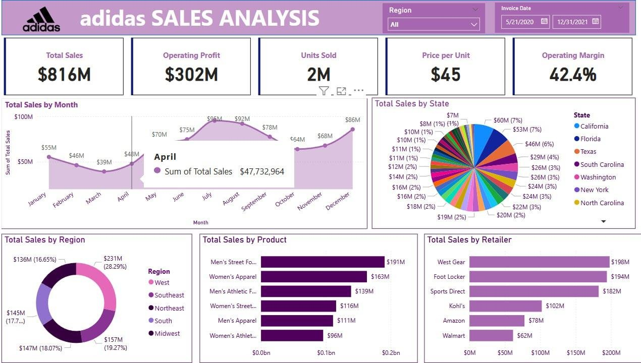
Dashboard Overview

Slide 14


Thank You

